Slide 1
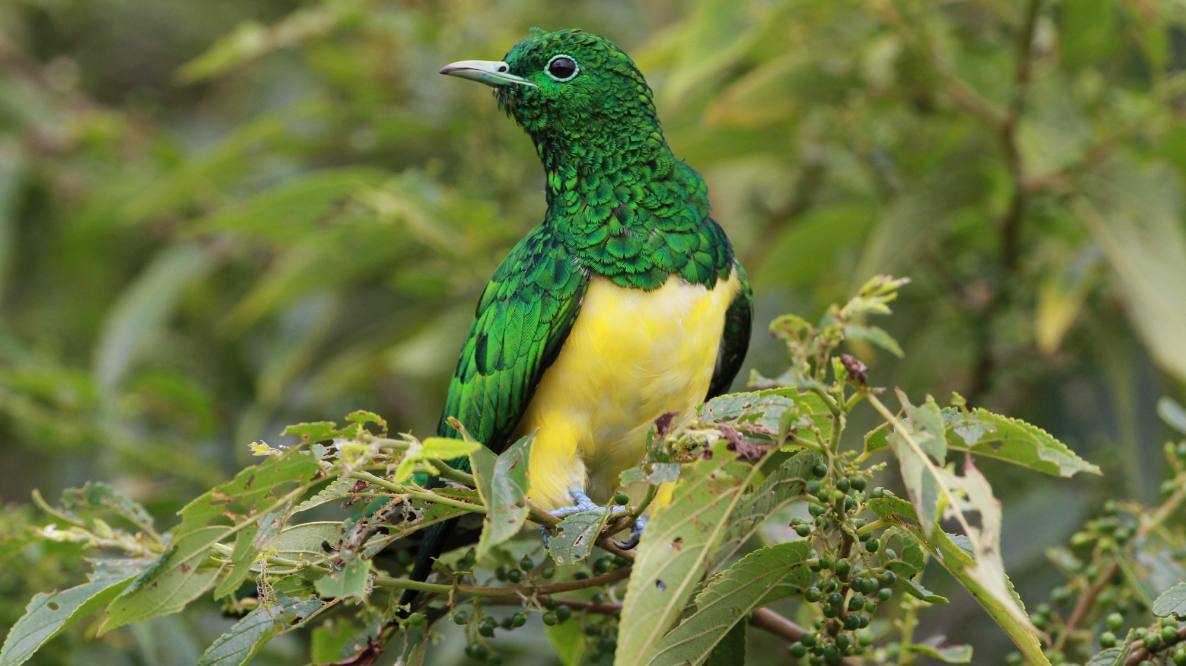
BeakPeek
Millennium
BIRDING MADE EASY AS FLY
Group 22

Slide 2

BEakPEEK
Core Quality
Requirements
Performance
usability
security
Reliability
Maintainability

Slide 3


CORE Quality
requirements
Performance
1.1 Be able to handle concurrent users.
Microsoft Azure
Load Balancing
1.2 Be able to handle concurrent messages and notifications.
Asynchronous Message Queues
Concurrent Notifications
1.3 Be able to handle low network speeds.
Offline functionality.
Data compression
1.4 No more than a two second response time.
Microsoft Azure
Load Balancing

Slide 4

CORE Quality
requirements
Usability
2.1 Easy to use.
Usability testing
Industry standards
2.2 Easy to navigate.
Consistent Patterns
Known Material Metaphors
2.3 Easy to understand.
Help buttons
Descriptive labels
2.4 Easy to learn.
Brief tutorial
Interface Metaphors
Notes:
Users without technical experience must be considered

Slide 5

CORE Quality
requirements
Security through azure
Our security standards are achieved through the use of Microsoft Azure and Microsoft Identity.
Through them, users are automatically authorised and authenticated correctly to their respective roles. (We are using role-based access control.)
Data integrity is also ensured through the use of checksums. Audits logs are created to track administrator’s activity.
Protect user data from unauthorised:
Access
Modification
Deletion
Disclosure

Slide 6

CORE Quality
requirements
Reliability
4.1 Be available 20/7.
Azure Redundant Servers
Major Maintenance from 22:00 – 02:00
4.2 Be able to recover from crashes and failures.
Automated restore processes
Robust error handling
Crash reports
4.3 Be able to survive upgrades & device migration.
Rollback implementation
Development for IOS & Android
User data online on Azure
4.4 Be scalable past 10 000 active users per month.
Azure credits for Microsoft servers
Efficient design
4.5 Must function with low bandwidth.
Download data for offline use
Offline processing is local
Notes:
Users without technical experience must be considered

Slide 7
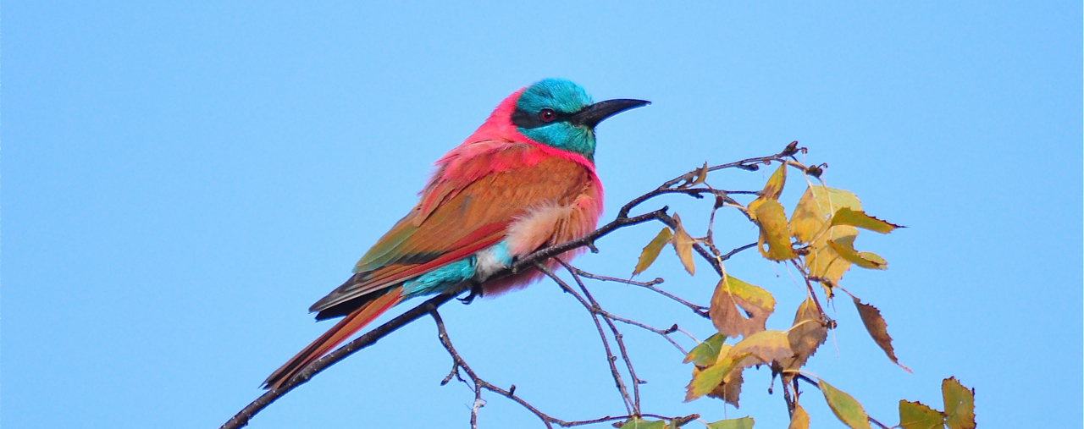
CORE Quality
requirements
Maintainability
5.1 Be easy to debug.
GitHub for version control
Extensive testing
5.2 Be updated without affecting user experience.
CI/CD pipelines for automated deployment
For large updates enforce app updates
5.3 Retrieve updated SABAP2 data automatically.
Automatically retrieve SABAP2 data updates
Automatically update local user data when they next connect to the internet
5.4 Be easy to maintain.
Well abstracted with modular architecture
Automated testing
Notes:
Users without technical experience must be considered

Slide 8

LIVE DEMO

Slide 9

ThankYou
BeakPeek
millennium.capstone@gmail.com
Group 22
Charl Pretorius

